Slide 1
Nature building Kit meets WFBR
Highlights of biobased materials @ WFBR
4-7-24, Edwin Keijsers

Slide 2
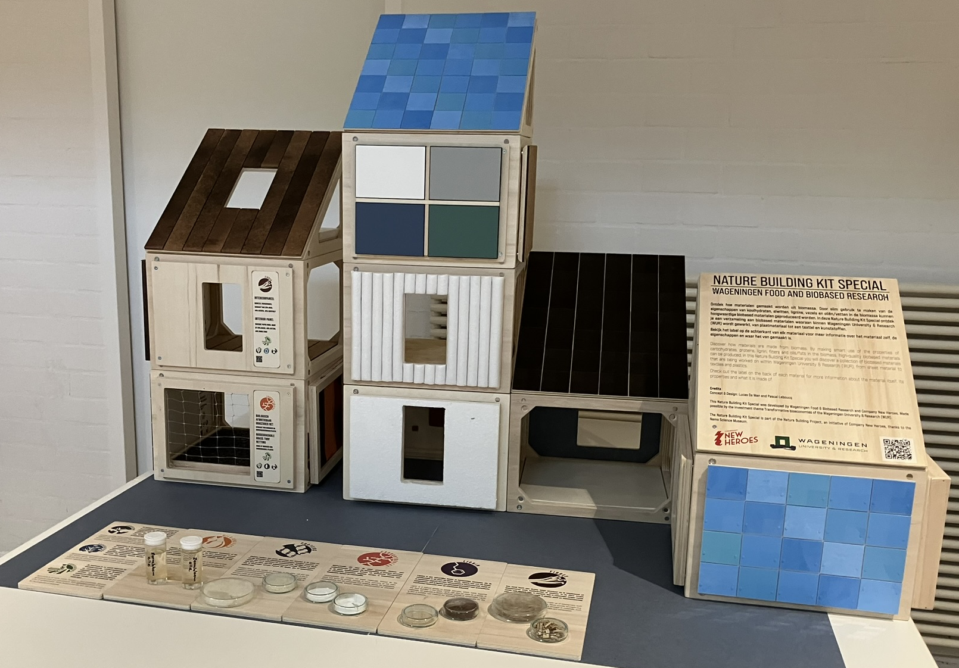
Biobased materials
Different crops, sidestreams, recycled materials
Different (building) products
Fibres, cellulose, lignin
Biobased plastics
Starch, oils
(Bio-) mechanical processes
Chemical processes

Slide 3
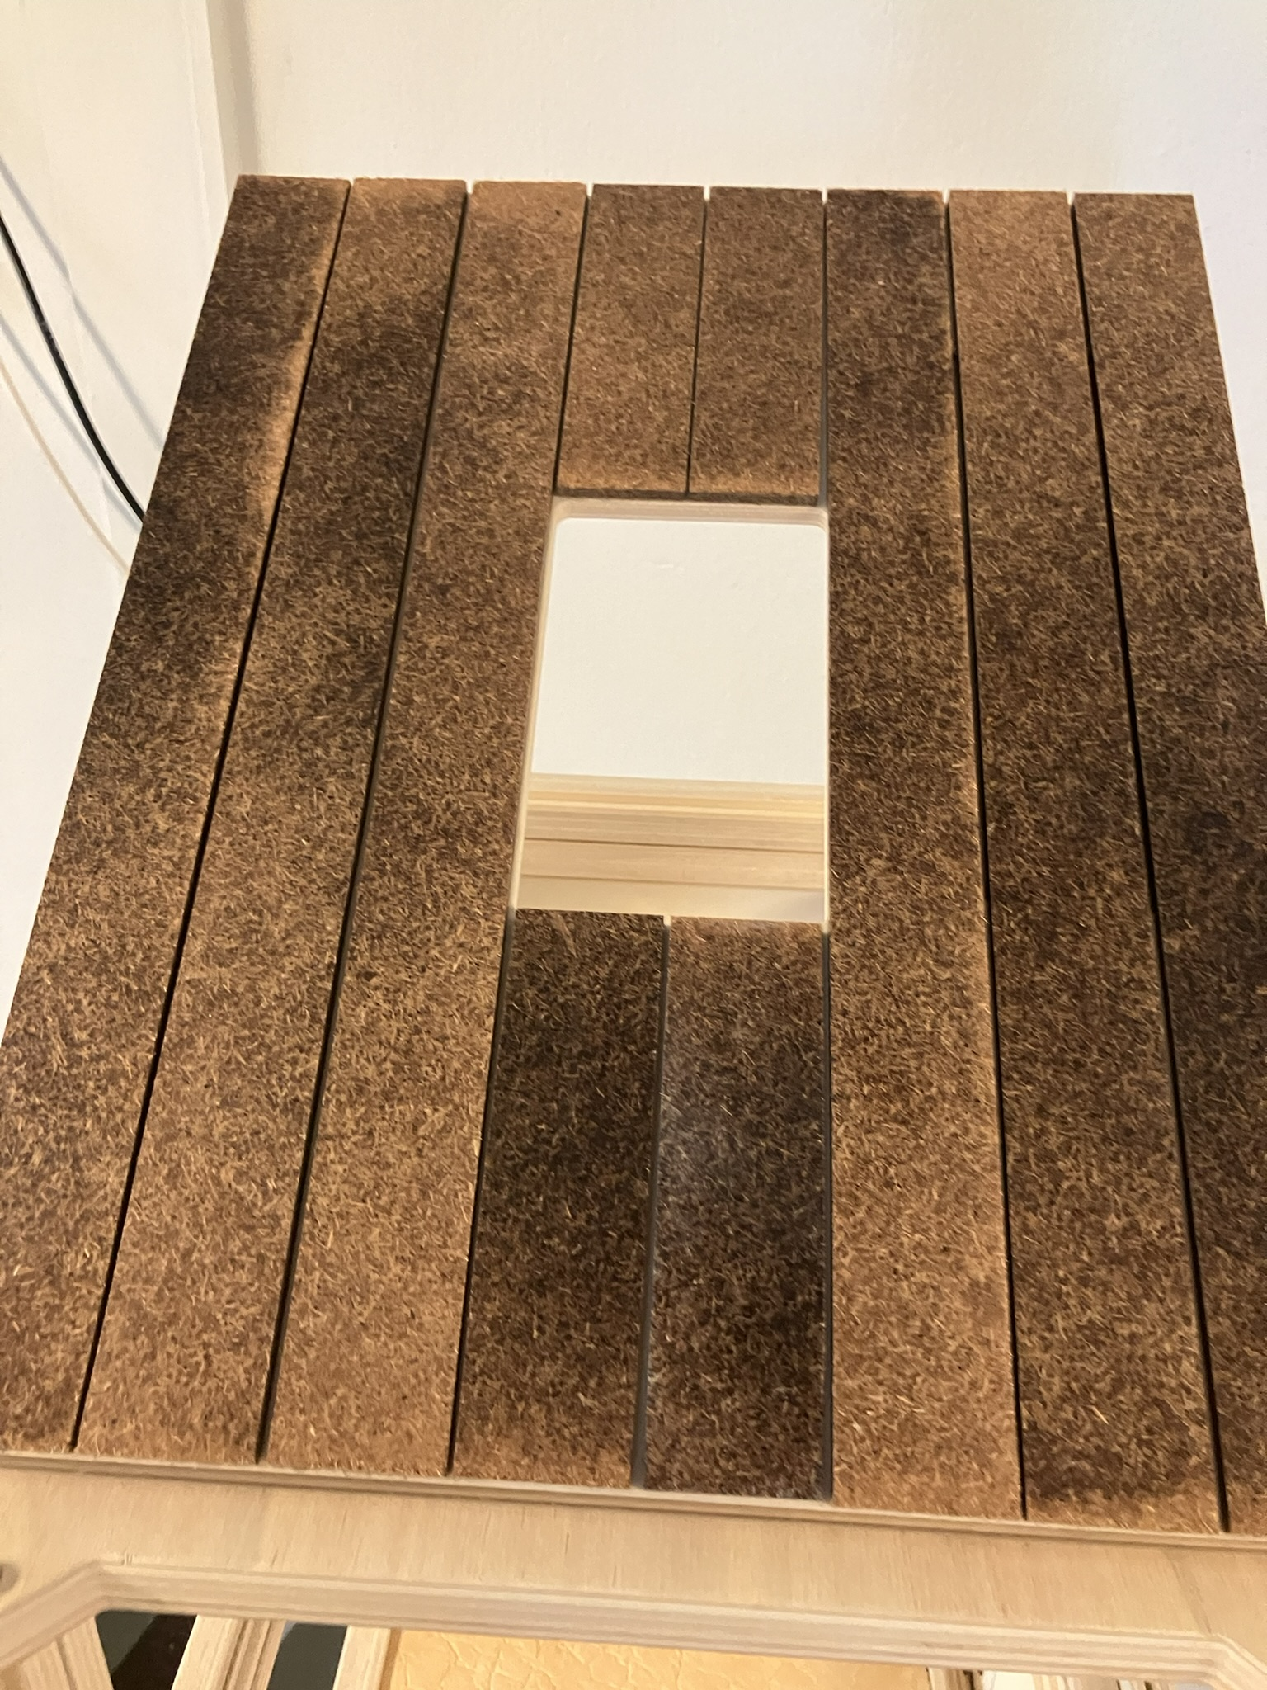
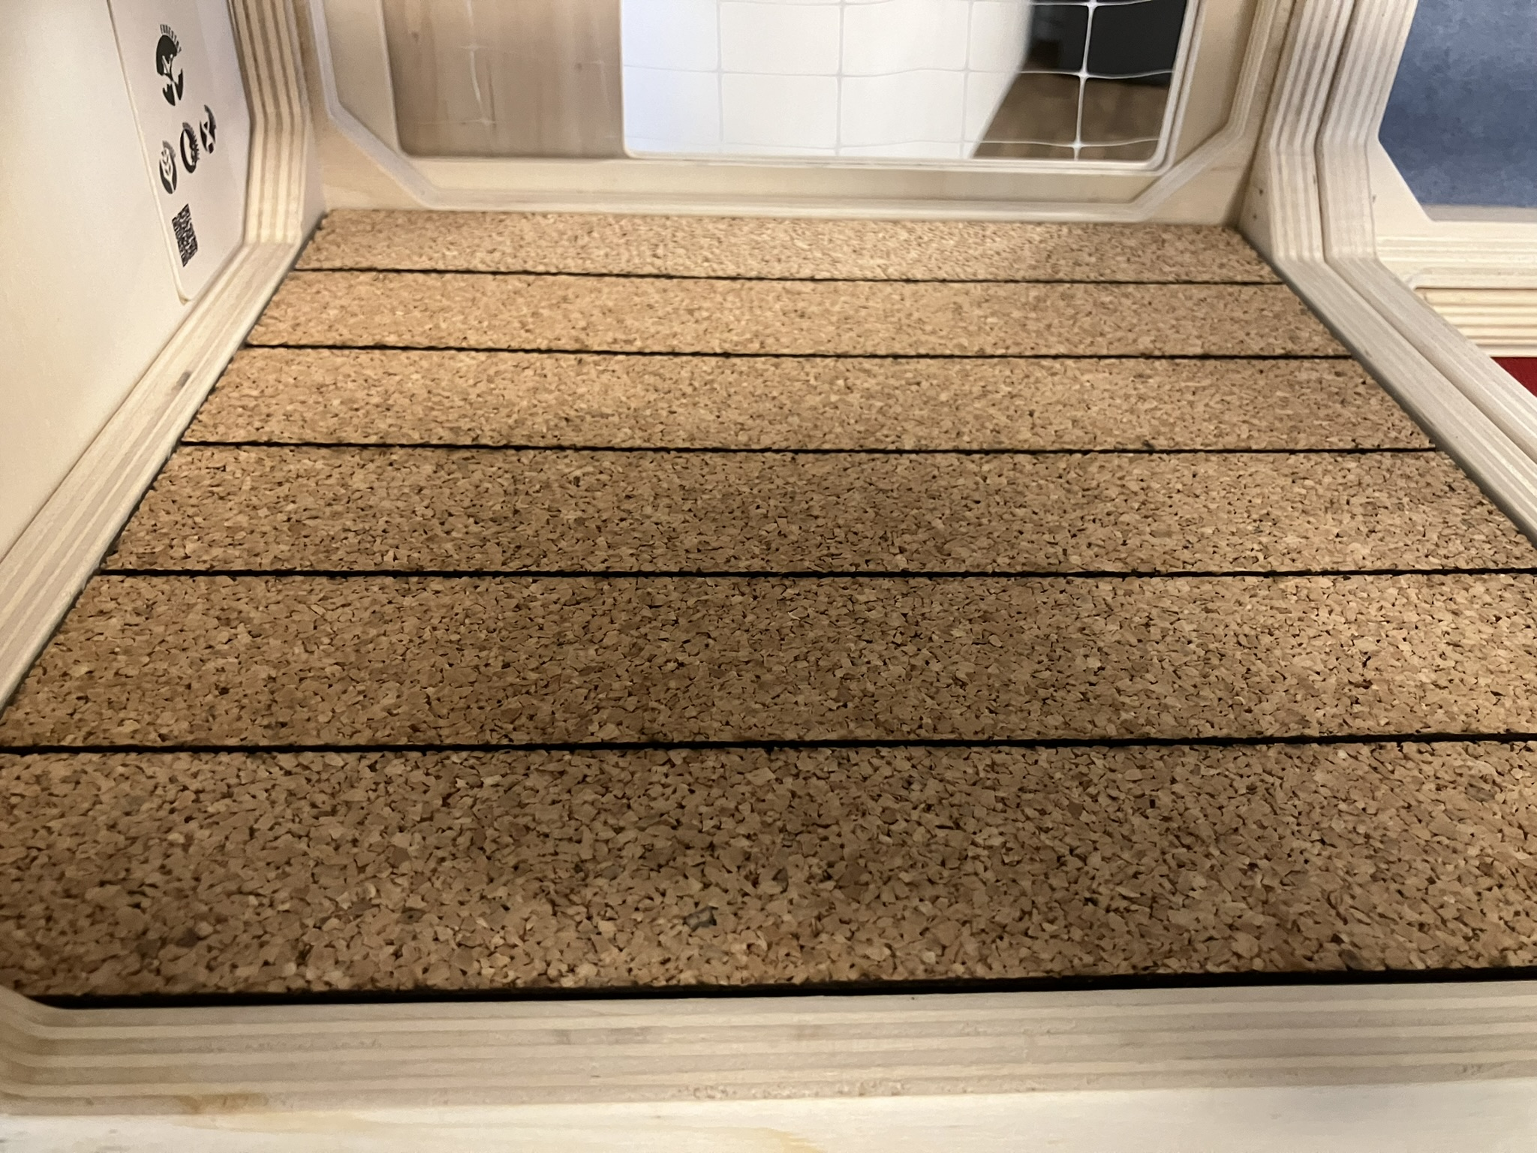
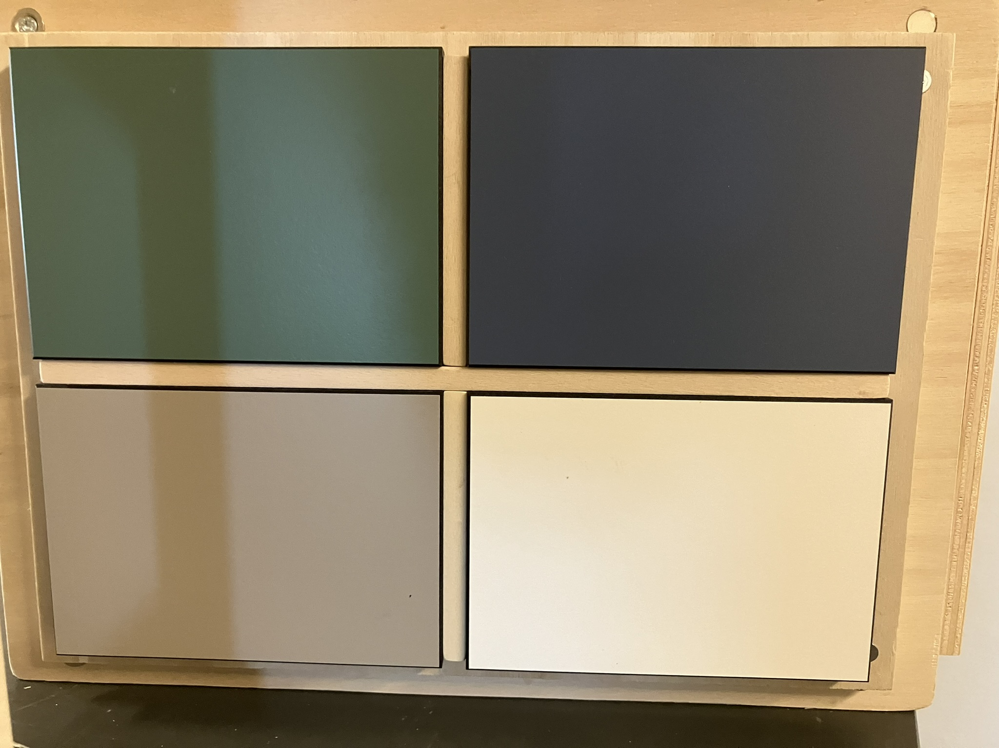
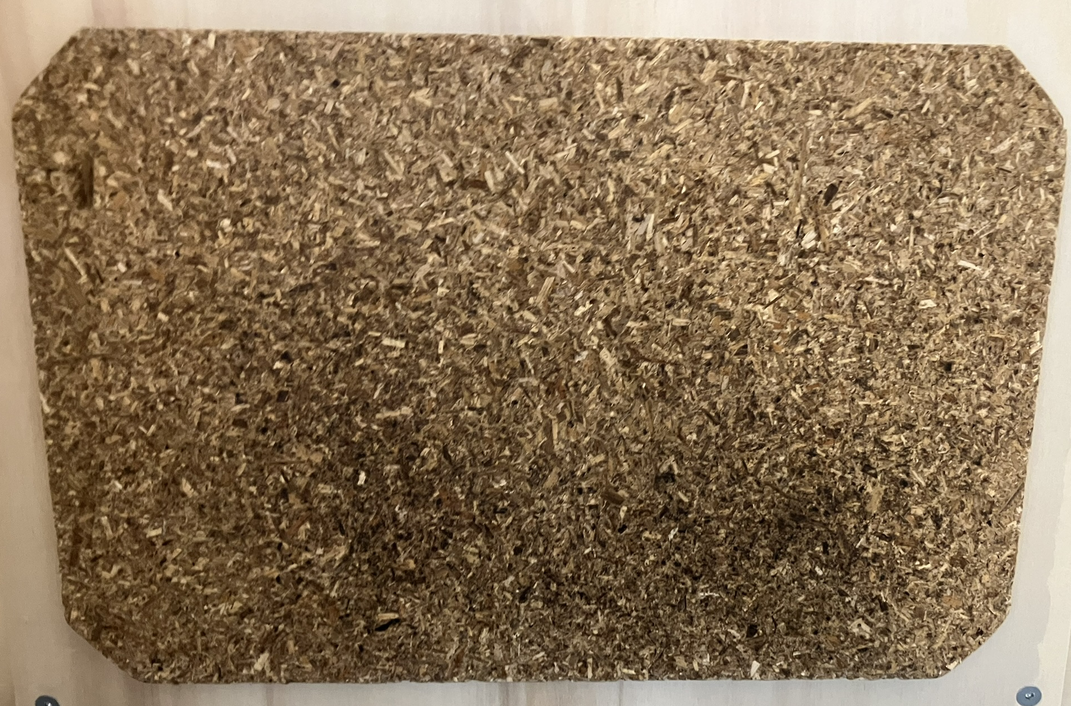
Board materials
Biobased, Product quality and processing time
Reed panels with biobased glues
Cork panel with furan resin
Trespa board with lignin as glue
Binderless board

Slide 4
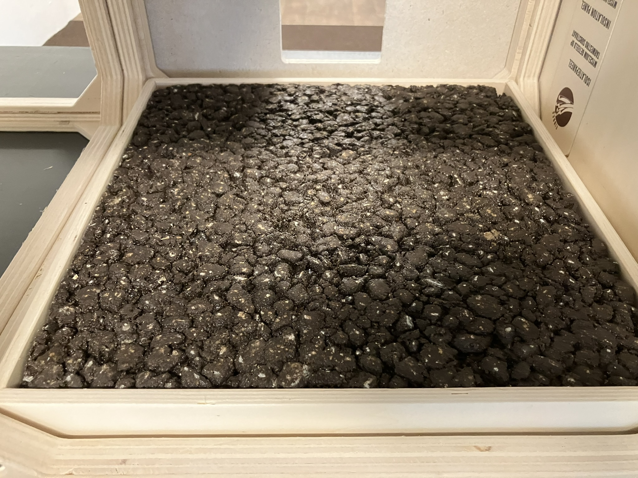
Asphalt
Lignin as replacement of bitumen

Slide 5
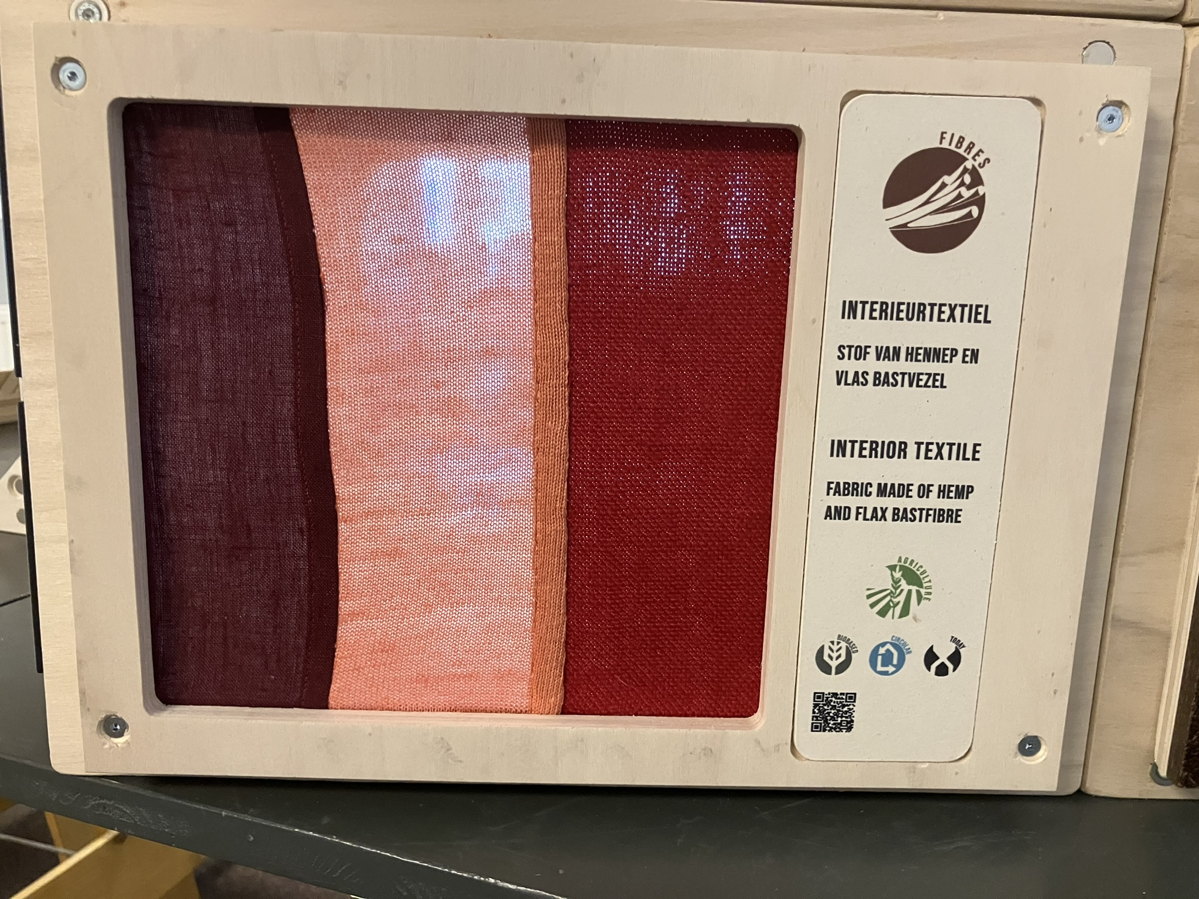
Textile
New sources
Recyclability
Processability
Natural fibres versus biobased
Paulien Harmsen

Slide 6
Paper
New resources
Added value

Slide 7
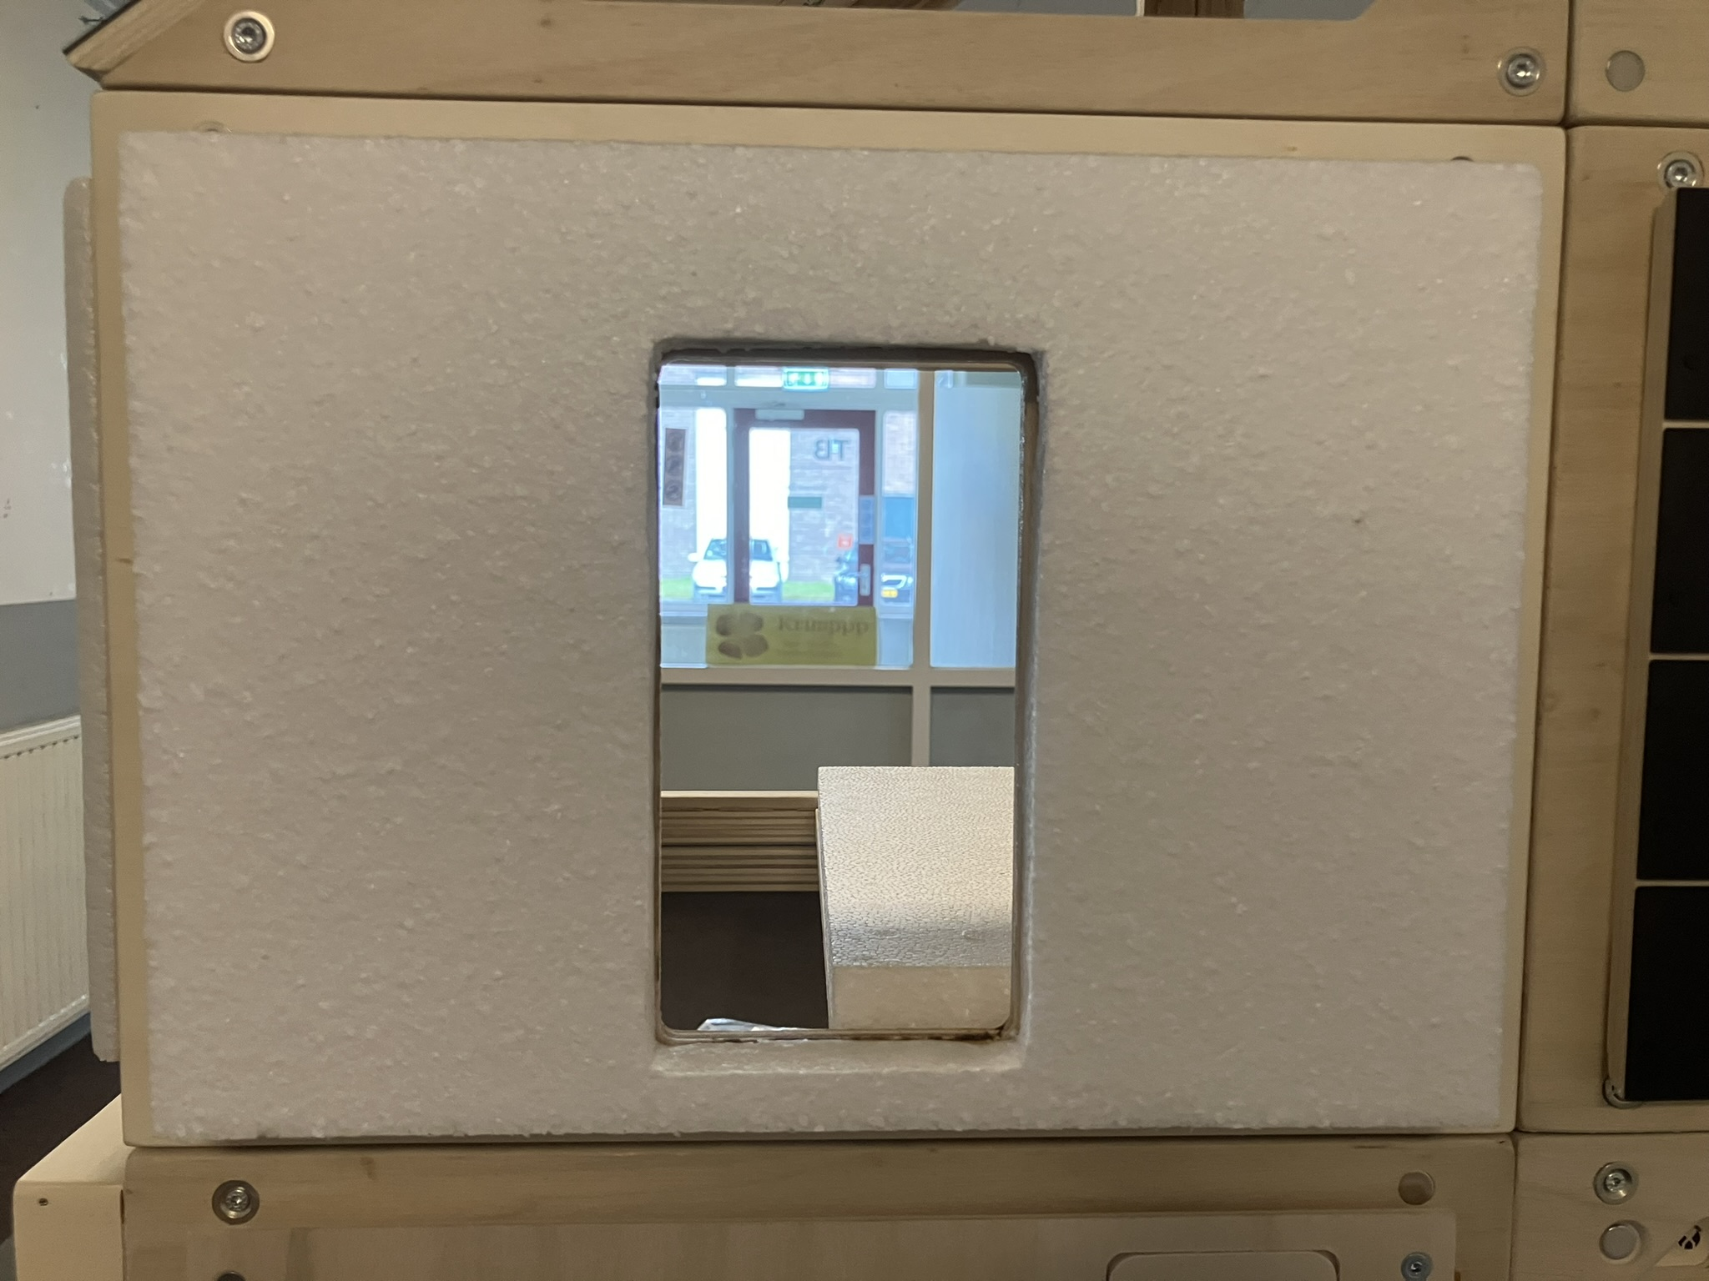
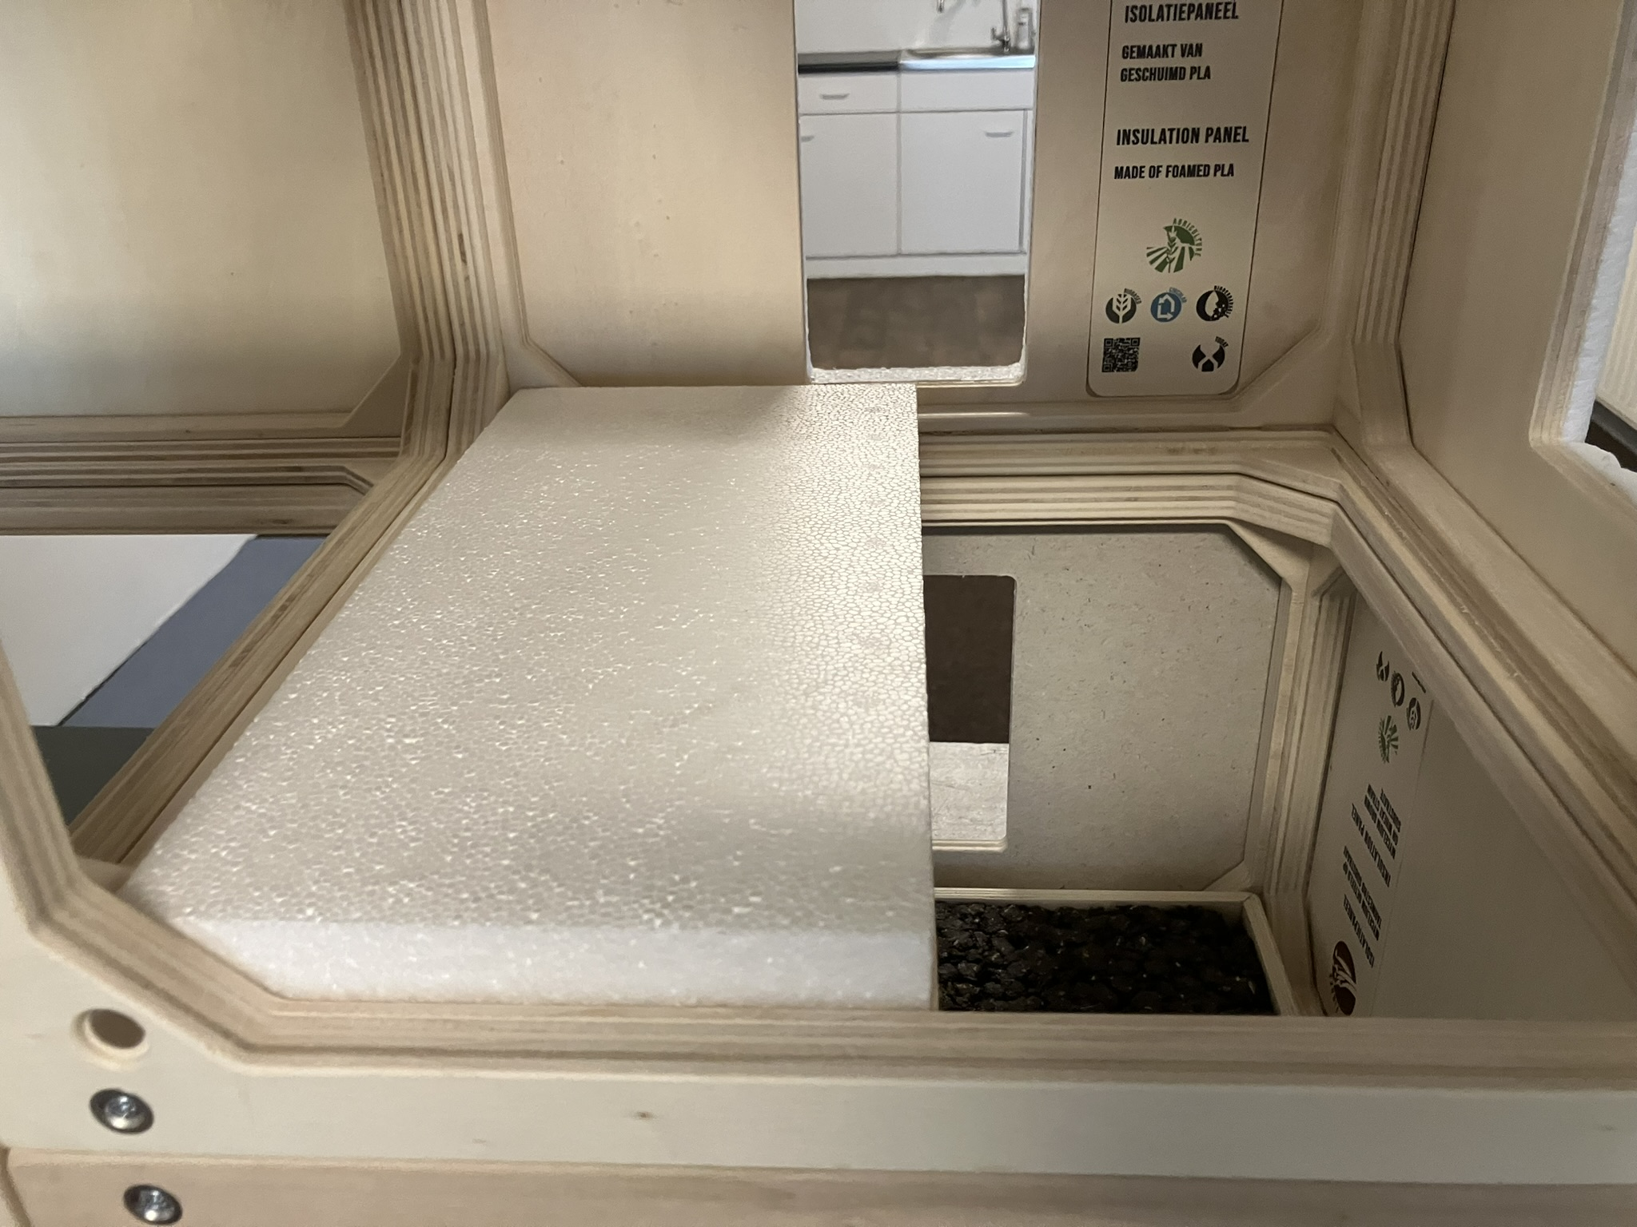
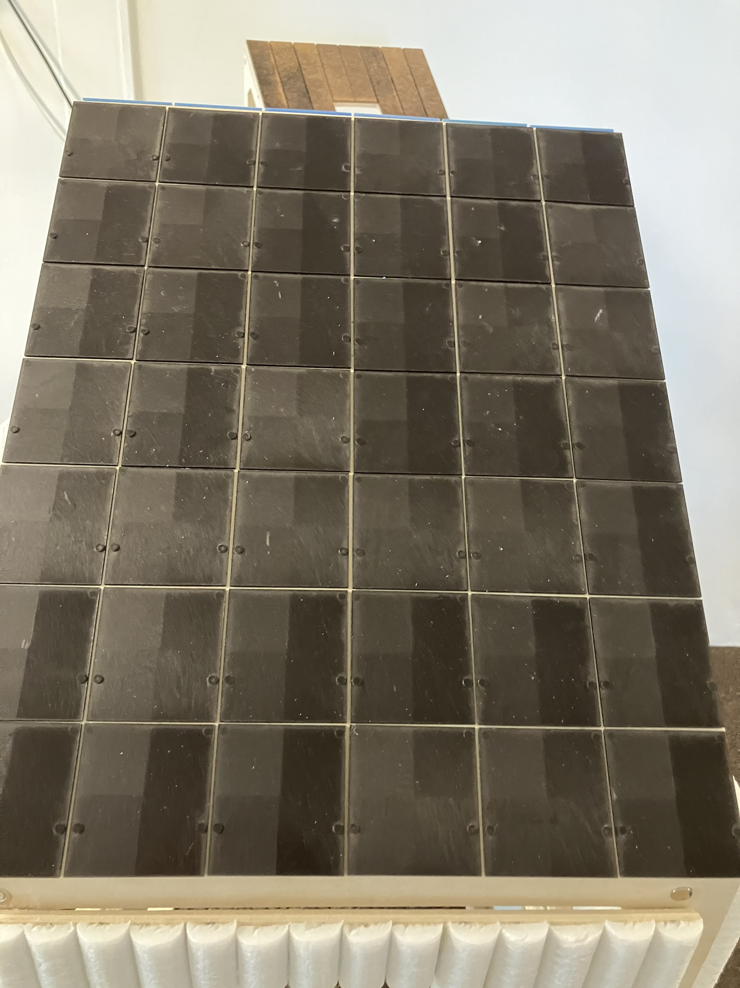
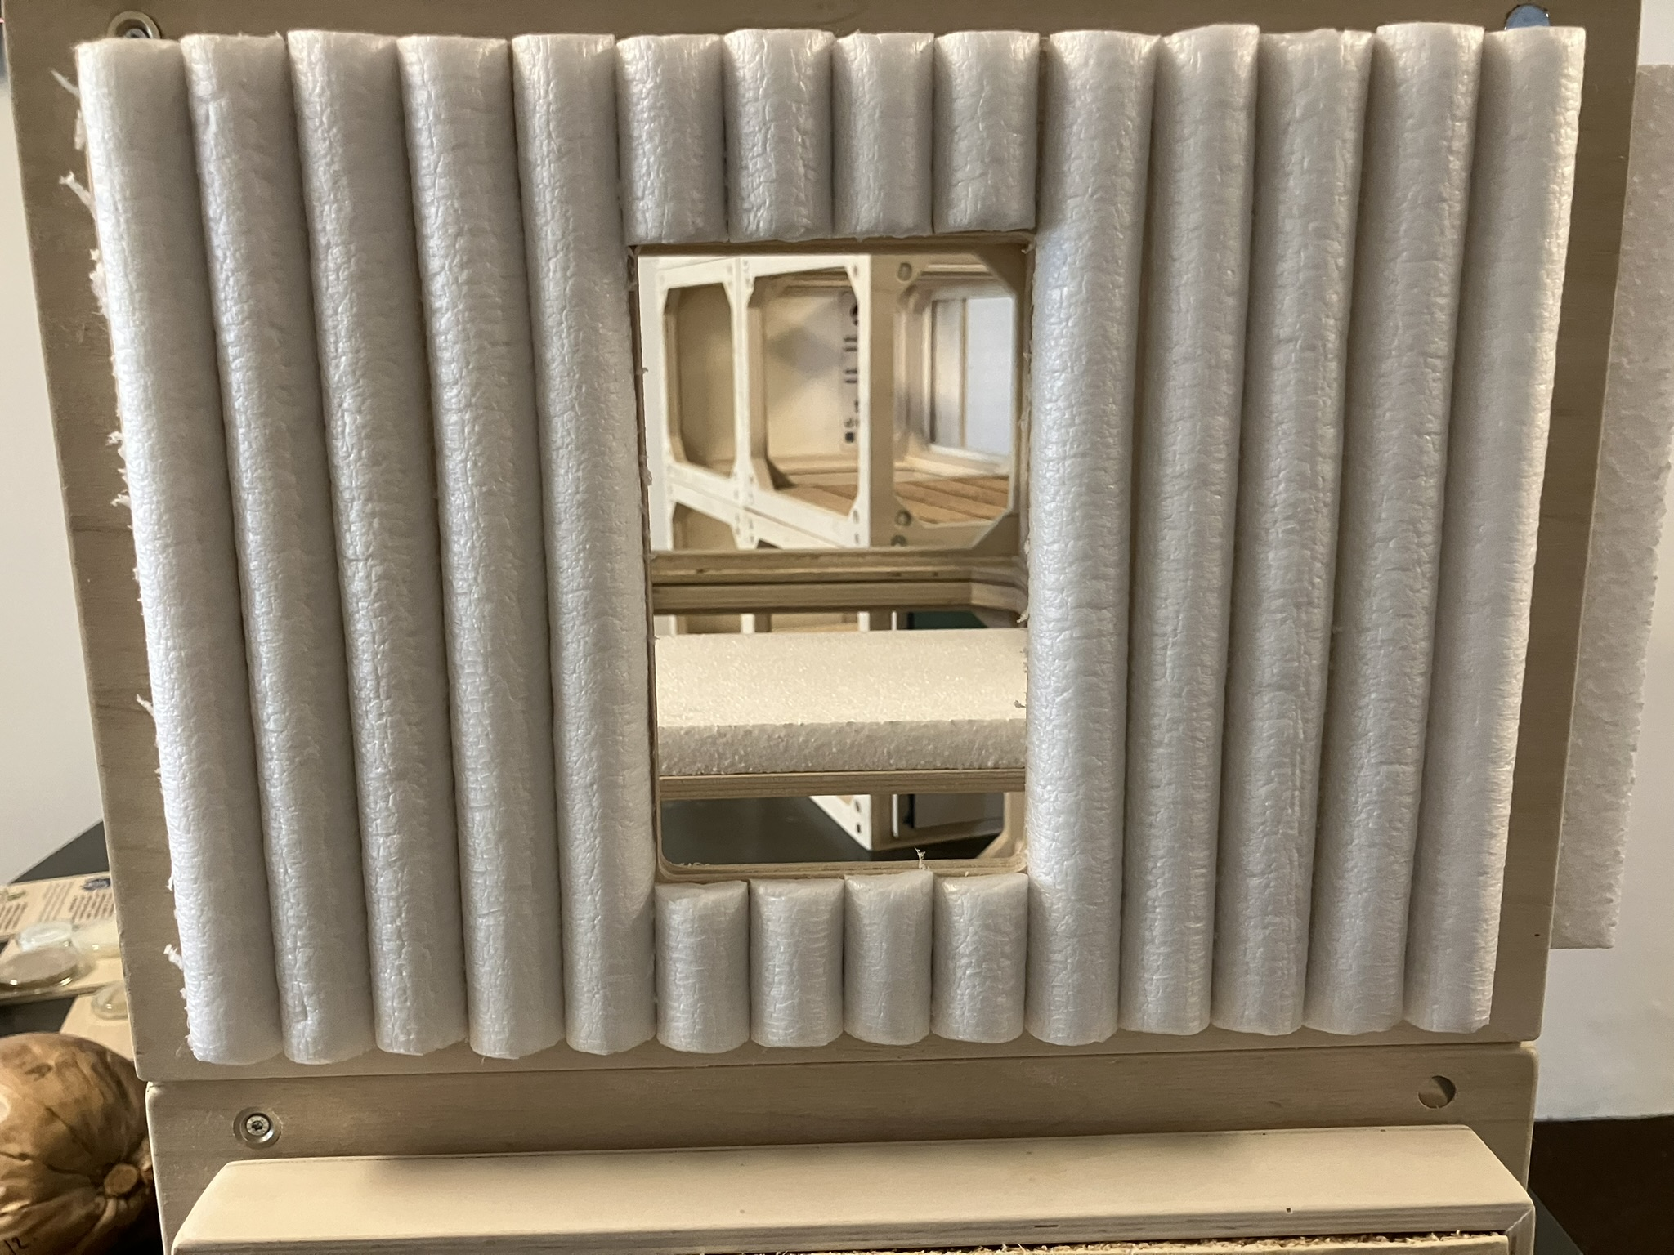
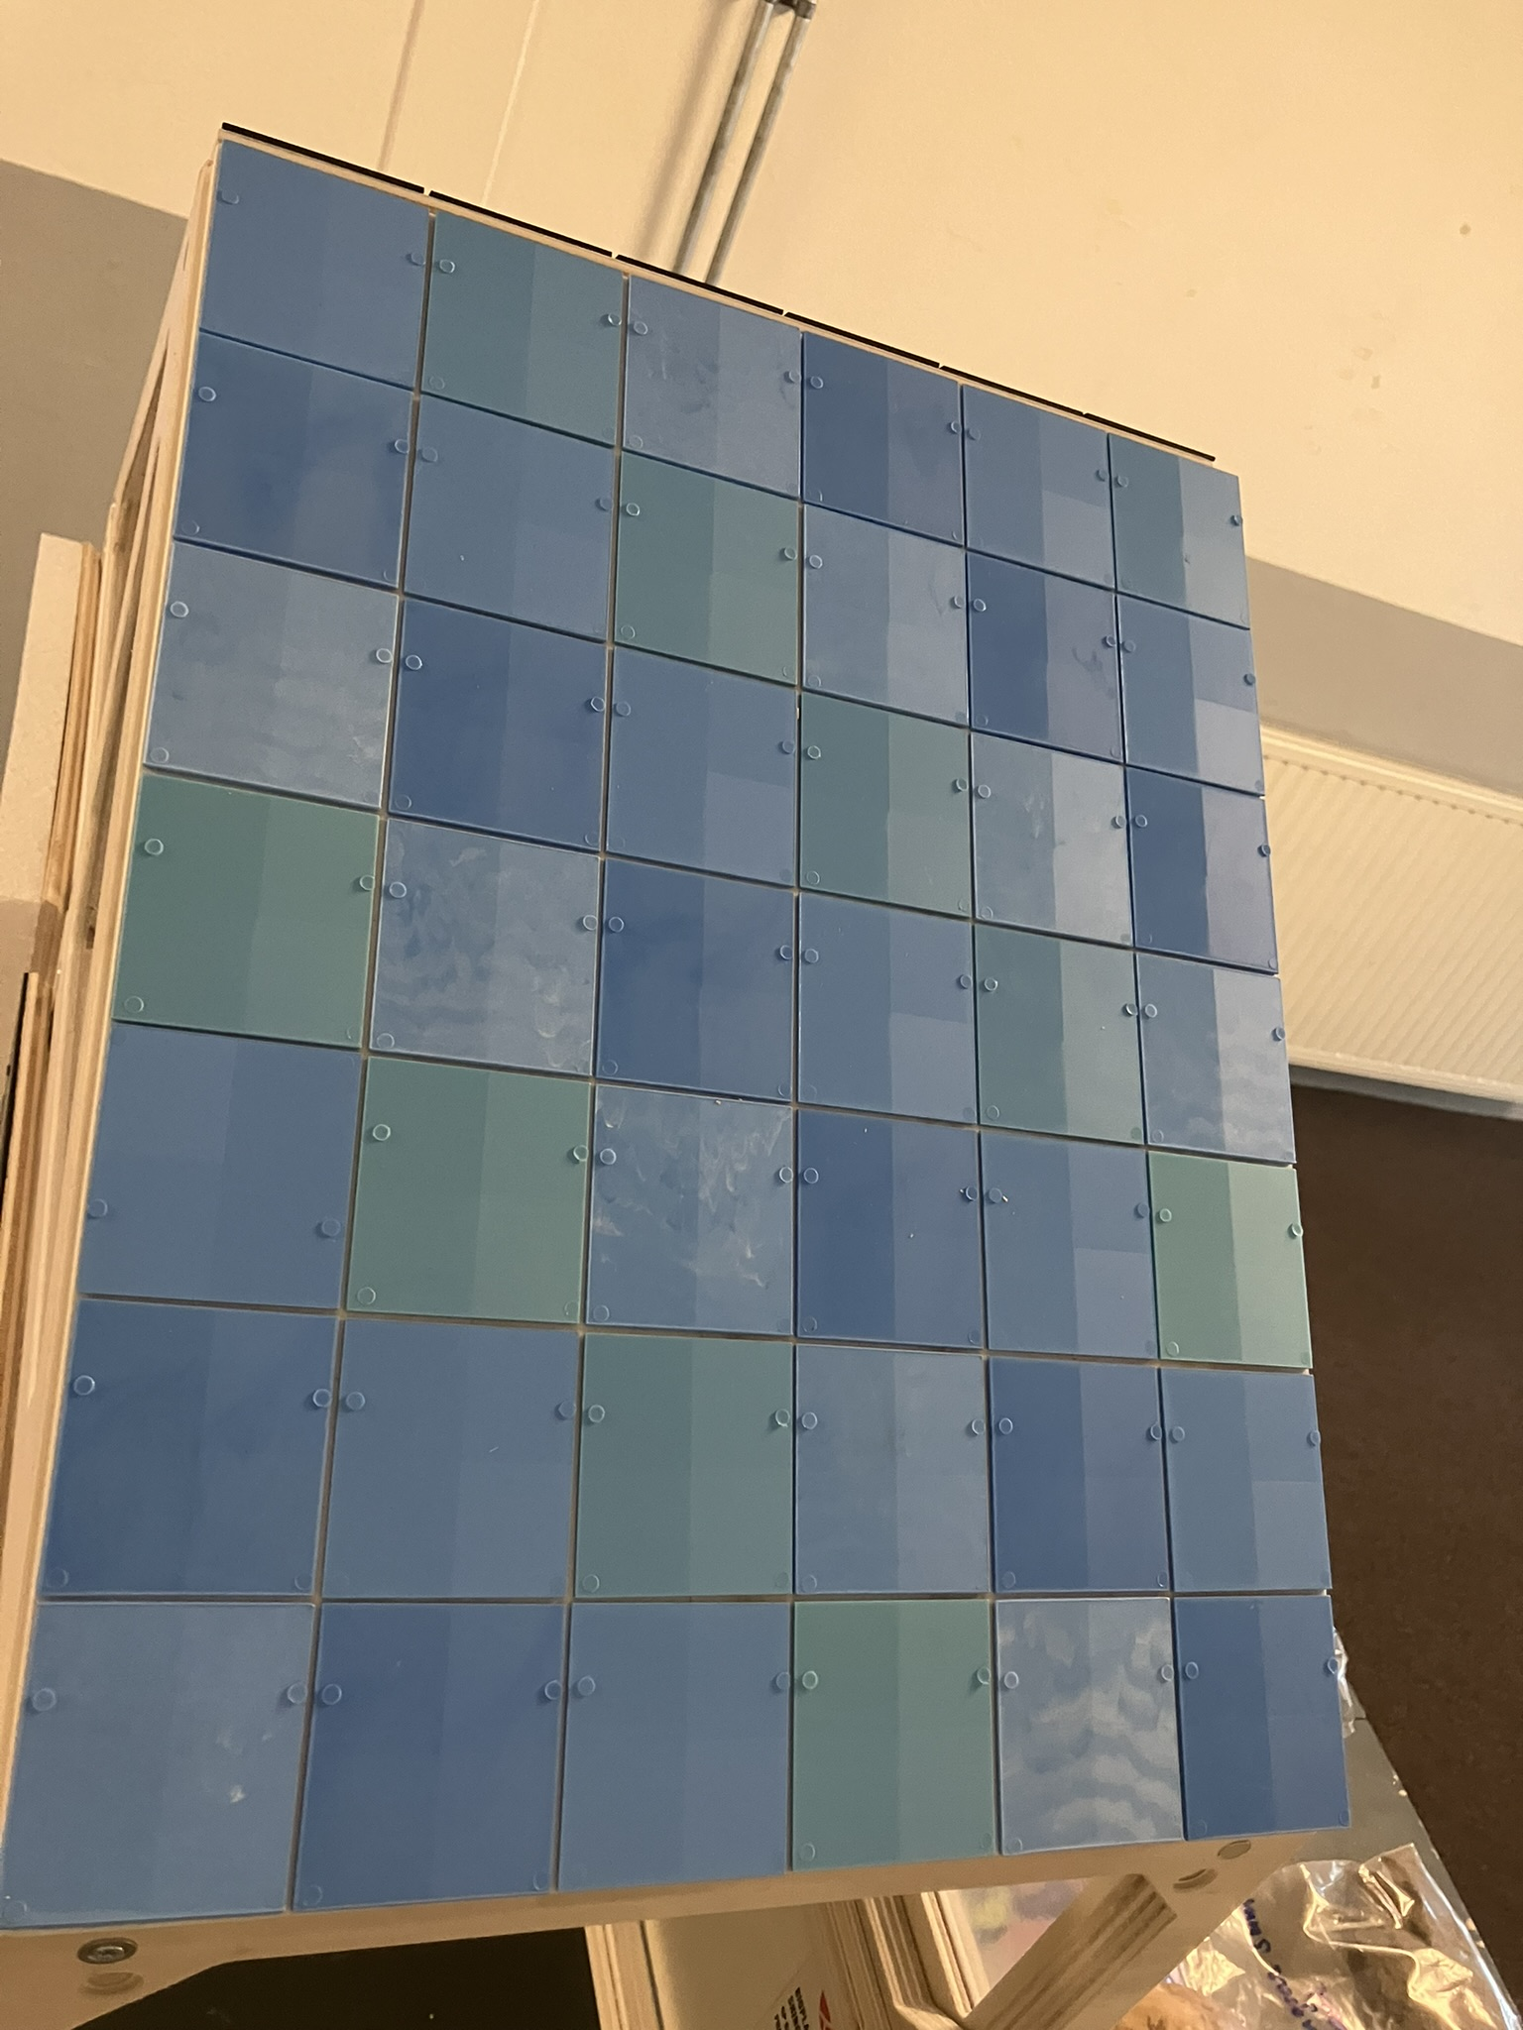
Biobased plastics & foams
New biobased plastics
New properties
Biodegradability

Slide 8
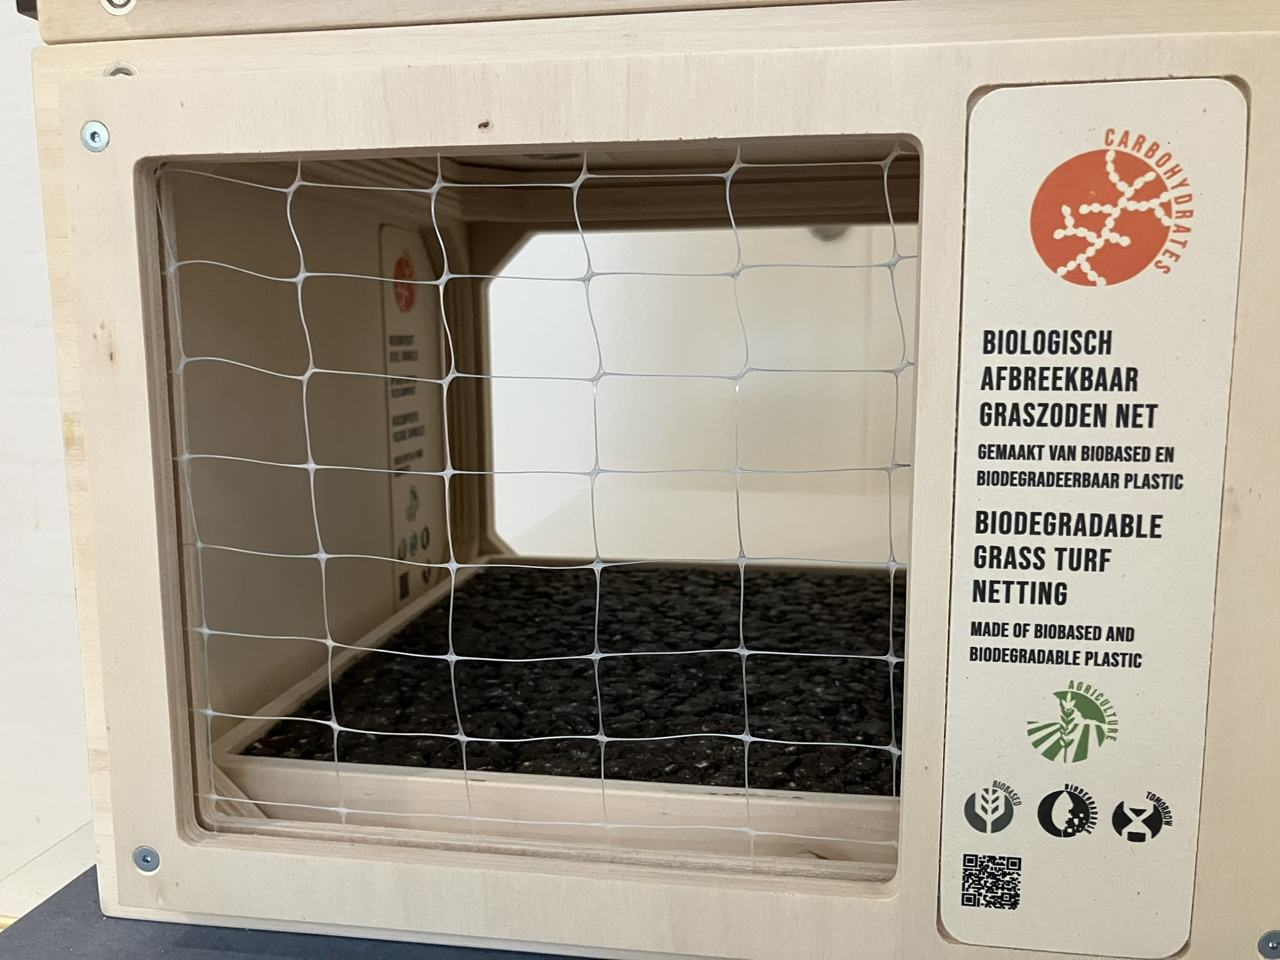
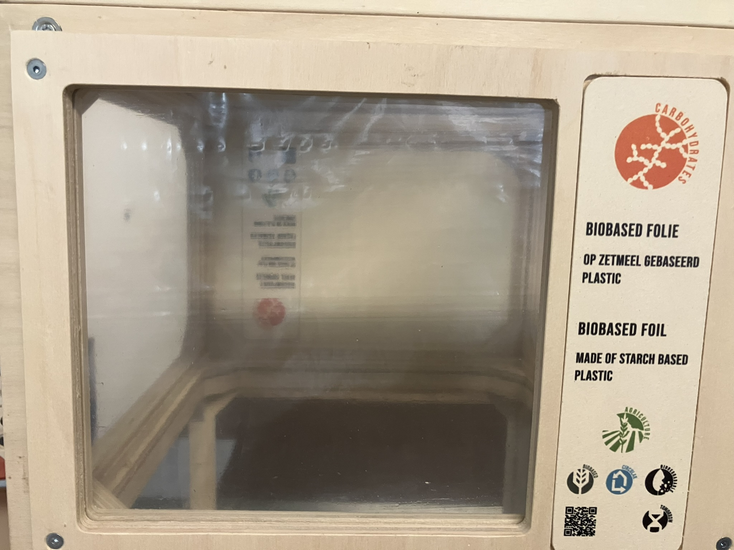
Biobased nets & films/coatings
New biobased plastics
New properties
Biodegradability

Slide 9
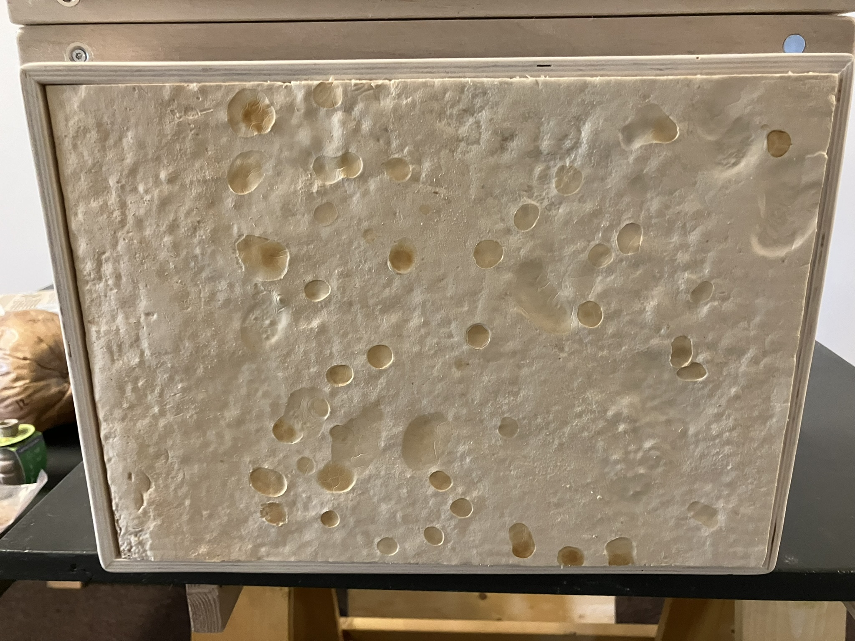
Mycellium insulation
New materials
New properties

Slide 10
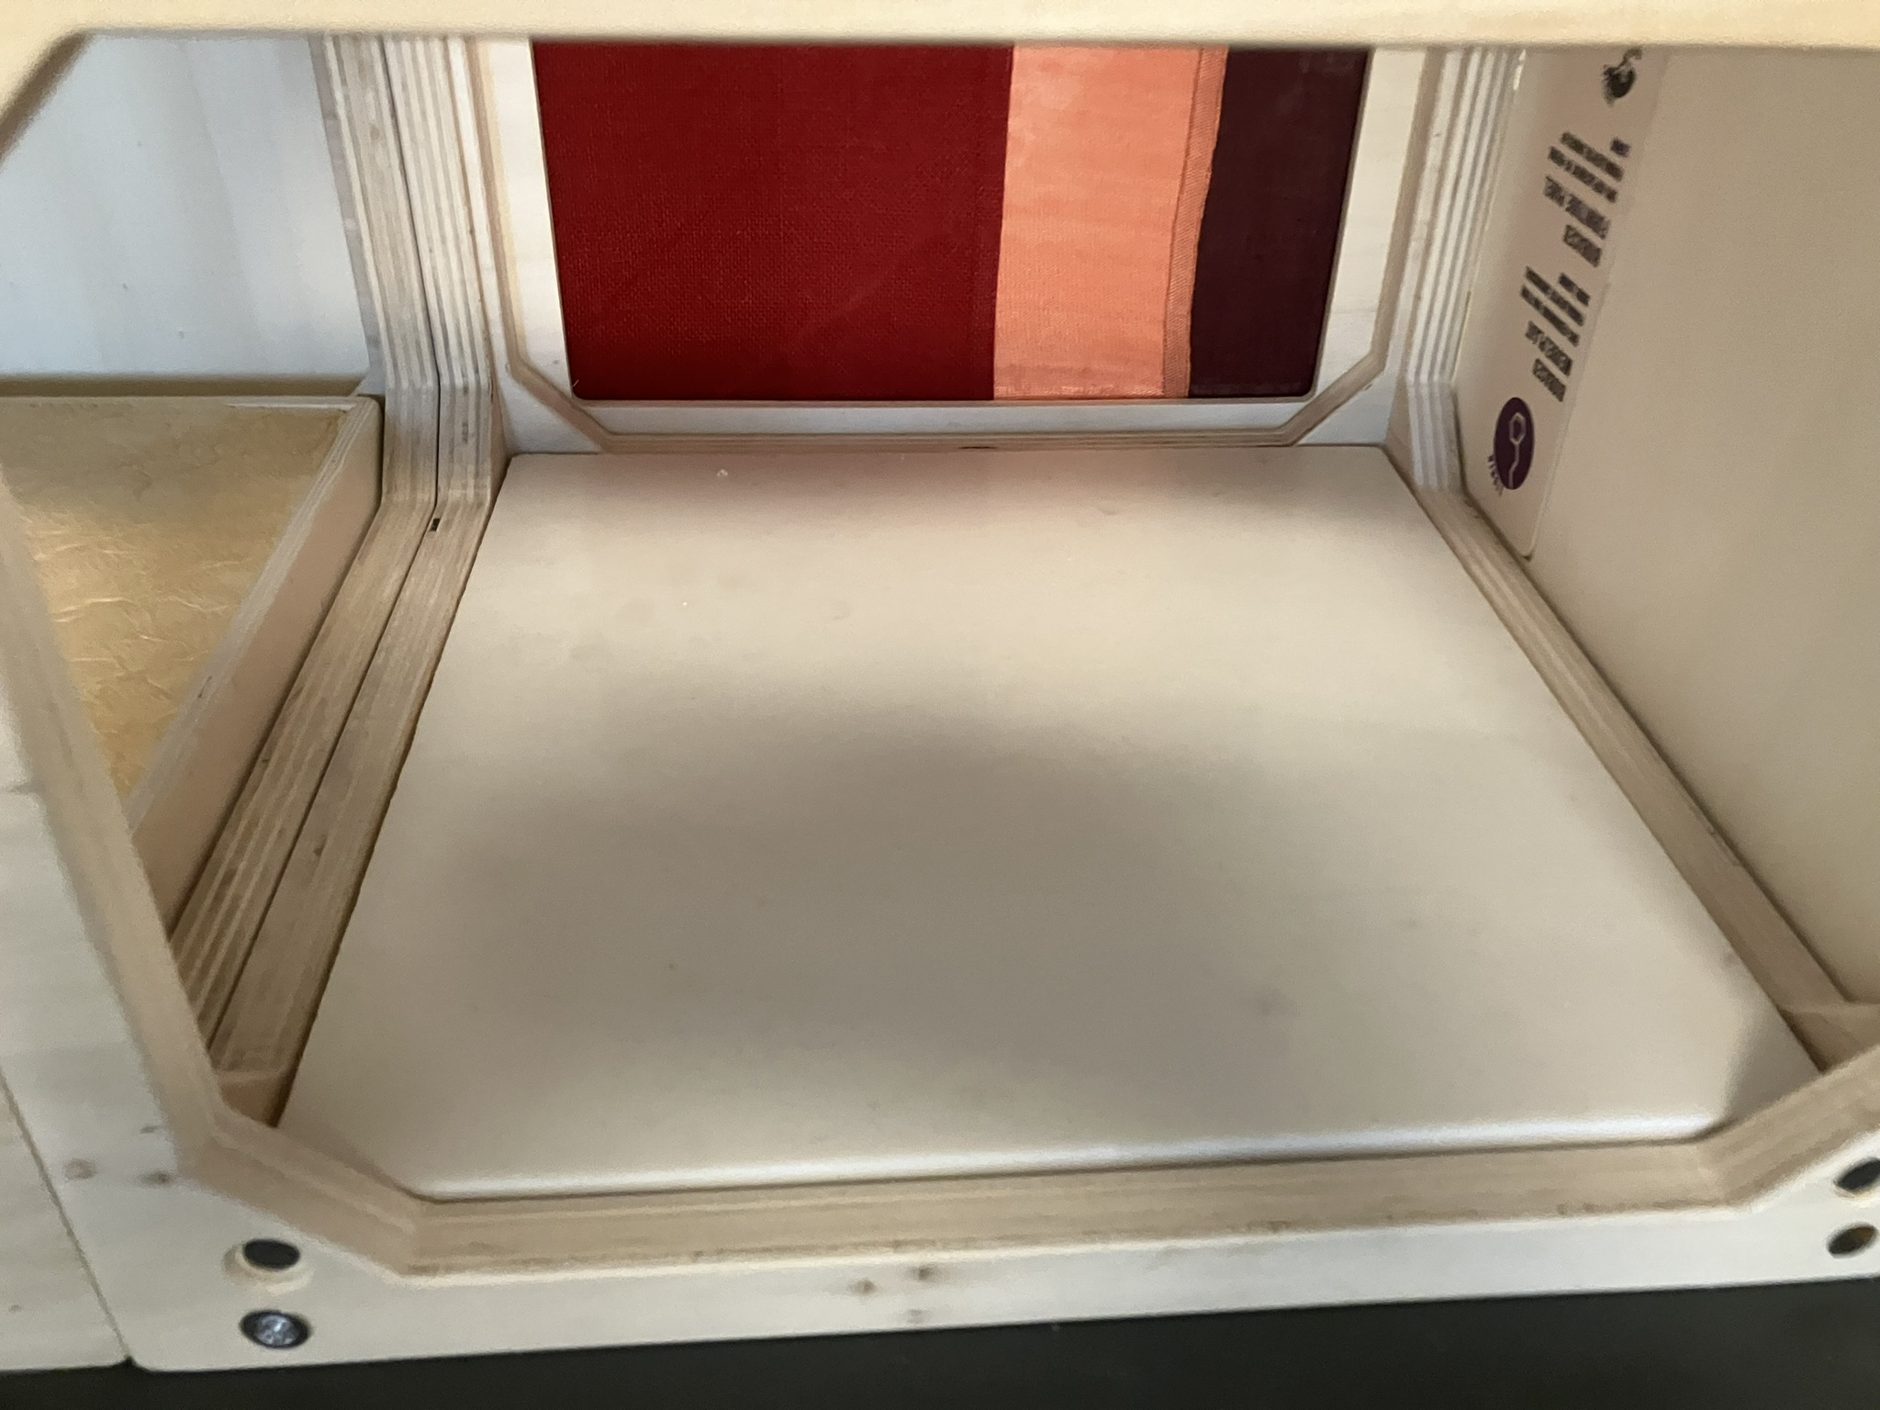
Oil based flooring
Advanced properties

Slide 11
Get inspired!

